Slide 1
Filters
Price
Product image
Product image
Product image
Under £10
c
Under £30
Under £50
Product name/price
Product name/price
Product name/price
over £50
Custom
Under £:
Product image
Product image
Product image
Age range
c
11+
Product name/price
Product name/price
Product name/price
13+
c
Over:
Product image
Product image
Product image
c
Under:
Product name/price
Product name/price
Product name/price

Slide 2
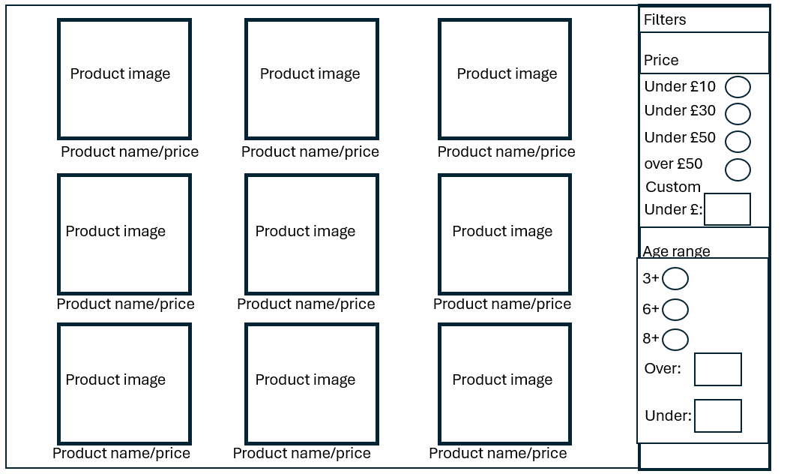
Grid display
Search:
fill box
checkboxes
fill boxes
checkboxes
fill boxes

Slide 3
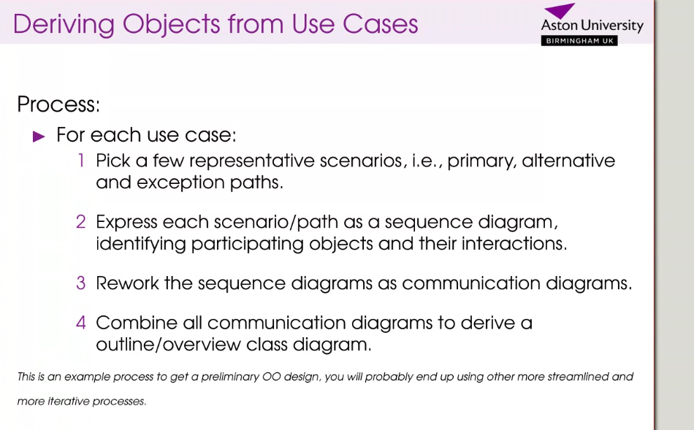

Slide 4
